Slide 1
Chorescence App
Kevin Grajeda, Helen Xu, Alwyn Zhang
A08
Notes:
Kevin

Slide 2
Introduction
Choresence is a web application for people who live with roommates, dormmates, or family members
Streamline the process of assigning and managing chores and tasks for roommates and household members
Create and manage groups
Create, assign, or share tasks within groups
Provide feedback on the tasks completed by fellow group members
Notes:
Kevin

Slide 3
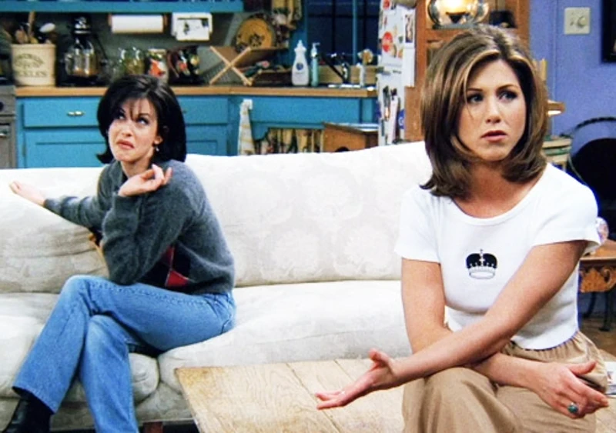
Status Quo
Many people live with roommates or family members
Not uncommon for people living under the same roof to forget their responsibilities or neglect them
Existing chore management applications offer little more than shared checklists
Some of these services are pay-to-use and offer value outside of chore management
In turn, their design is not focused on task-sharing and user-group management
Notes:
Kevin

Slide 4

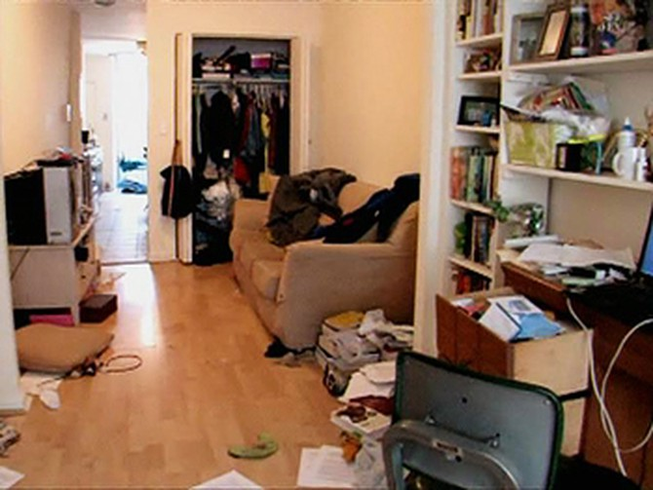
Observations
-An environment of little communication
-Lack of coordination with tasks
-Conflict between housemates
-Certain housemates ending up doing most of the work
-Chores/tasks not being completed on time or at all
-Overall poorer living experience
Notes:
Kevin

Slide 5
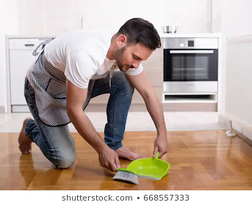
Story
Confrontation is awkward and undesirable, especially between new roommates
Close friends and family are easy to talk to, but it is even easier to waive responsibility when living with them
In some cases, people would rather complain about it elsewhere than confront their housemates
Some housemates ending up doing most of the work
Notes:
Helen

Slide 6
Insight
According to a survey by TaskRabbit, 78% of people “have had a fight over household chores in general”
Common fights: decluttering (41%), clearing the shower drain (30%), folding laundry (23%)
There is a general increase in people living with roommates
32% of American adults lived in a shared household in 2015 (vs. 29% in 1995)
More common in urban areas; almost ½ of LA adults live in doubled-up households
Result of delayed marriage rates, student debt, and housing inflation
May have been perpetuated by the 2008 recession
Research on social dynamics in non-romantic cohabitation reveals that motivations behind roommate behavior often don’t align with how they’re perceived, due to differing perspectives
https://www.realsimple.com/home-organizing/cleaning/chores-arguments-taskrabbit
https://www.theatlantic.com/family/archive/2018/08/the-strange-unique-intimacy-of-the-roommate-relationship/567296/
Notes:
Helen

Slide 7
Analysis
-With the number of people sharing living spaces on the rise, there is a growing need for a possible solution
-Factors that led to an increase in the past, like the 2008 recession, may be in play again
-With more people living together, the amount of potential conflicts rises.
-Many would benefit from reducing or preventing conflict between roommates
Less Conflict
More Work Done
Better Living Conditions
Notes:
Kevin

Slide 8
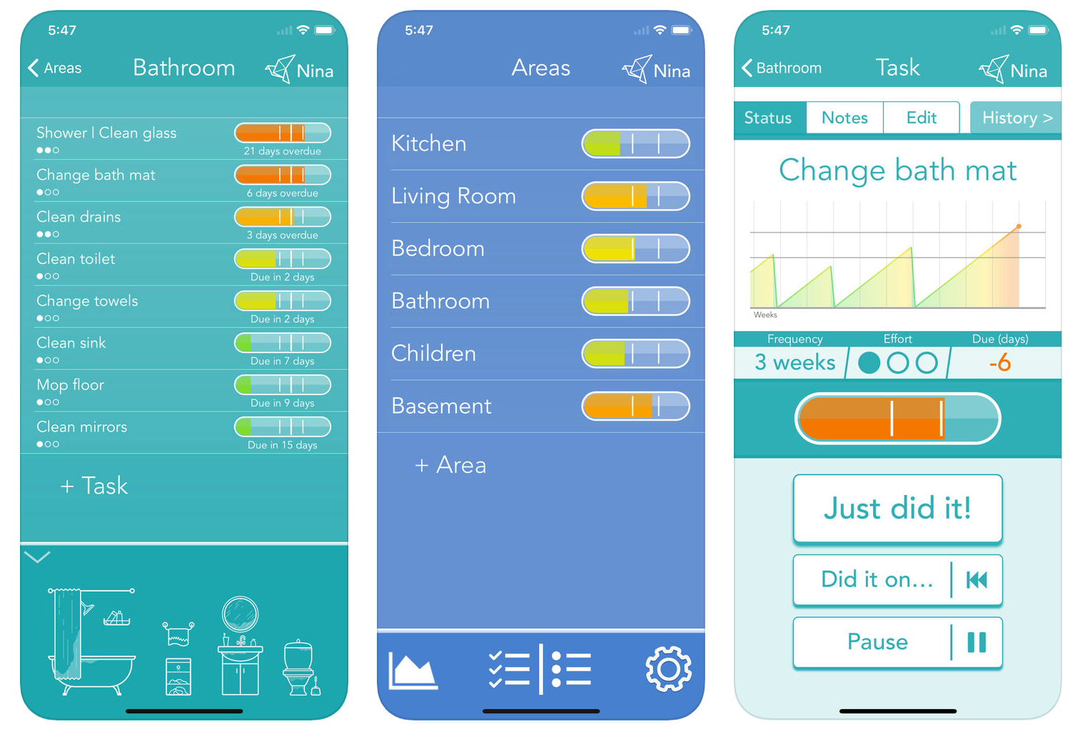
Analysis
No exact solution focused on solving these issues
Existing housekeeping apps are less encompassing, often made for and marketed towards parents with children
Issues with existing applications:
Insufficient task management capability
Lack moderation tools
Limited functionality
Do not facilitate communication between users
Tody, a chore management app focused on cleaning
Notes:
Kevin

Slide 9

Analogy
More often than not, new college roommates are complete strangers to each other
Through our platform, a group of new roommates create and join a group together, adjusting the settings and permissions as they see fit.
They can set up a weekly room cleaning task and a garbage disposal task every 2 days, automatically assigning a group member to complete them
The roommates may view the task history to see who completed previous tasks and provide feedback
Notes:
Alwyn

Slide 10

Solution - Design
Our application seeks to benefit users by:
Giving users more options for task management
Providing the ability to create and moderate user groups
Allowing and encouraging users to provide feedback to each other
Connecting housemates together in the platform
- Give an greater overall sense of control for housemates
Notes:
Alwyn

Slide 11
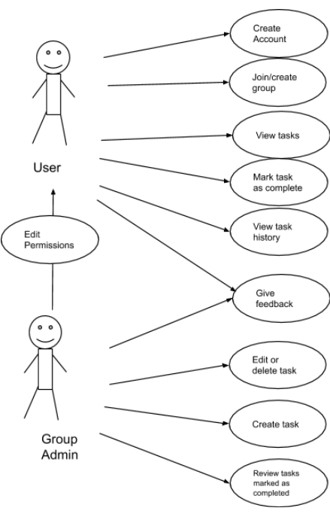
Overview - Use Cases
Users register for an account using their email
Same account can be used for multiple groups
Users create groups and adjust various settings
Group admins may edit the permissions of other users or appoint them as additional admins
Admins and permitted users create and assign tasks to group members
Users may view completed and unresolved tasks, mark tasks as complete, and provide feedback on completed tasks
Notes:
Alwyn

Slide 12
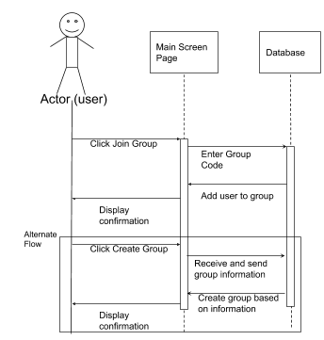
Group Creation and Moderation
Users can create and administer groups for their housemates
Others can join groups via invites
Admins of group can set permissions enabling or preventing other people in the group to create/edit tasks, provide feedback, or invite others to the group
Admins can appoint other users as admins
Notes:
Kevin

Slide 13
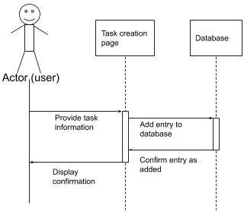
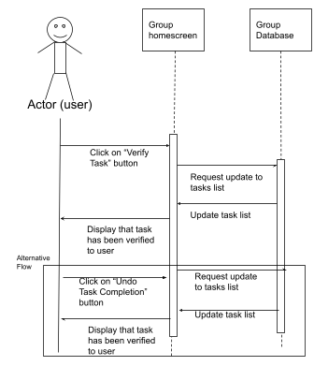
Task Creation and Management
Depending on the group settings, task creation and editing may be limited to admins and some appointed users or available to all users within a group
Tasks may be set to repeat periodically
Tasks may be assigned to a user upon creation, automatically assigned to the user with the least recently complete tasks, or left unassigned
Permitted users may notify fellow group members if...
They cannot complete a task assigned to them
A task has been incorrectly marked as complete
Notes:
Task creation sequence diagram top, task completion sequence diagram bottom
Helen

Slide 14
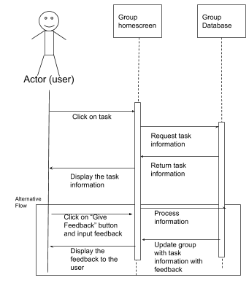
Task History and Feedback
Users may view a list of previously completed tasks
Task name and description
Group member who completed it
Time and date it was completed
Users may provide feedback on completed tasks
Rating out of 10
Type a comment
A few preset comments
Depending on the settings and permissions set by group admins, feedback may be provided anonymously, and/ or disabled partially or entirely
Notes:
Alwyn

Slide 15

Advantage
Untapped market for a user-centered shared tasklist service
Many existing solutions are buy-to-use, while ours will be free with no restrictions for any user
Customizable permissions for users (vs. having one administrator)
By providing a way for people to give feedback, we facilitate communication and appreciation between users
Notes:
Helen

Slide 16
Ethos
We believe many people will benefit from and want to use a service like ours
The current economic and social landscape may further increase demand
We plan to have a completed prototype ready by June 2021
With an established user base, we may look into expanding on our features and rebranding into a general shared task management platform, suitable for students, businesses, or teams of any kind
Notes:
Helen

Slide 17
Post Implementation Review
What we did right
Submitted all deliverables on schedule
All team members were equally involved throughout the process
Closely followed to guidelines in creating documentation
What we did wrong
Errors in documentation
Completed most deliverables the day before the deadline, resulting in insufficient time to thoroughly review
Overlooked some use cases when creating system models
Notes:
Alwyn

Slide 18
Post Implementation Review
What we would change
Draft a more complete concept of the product earlier in the process
Complete documentation ahead of the deadline so we can review it more thoroughly
Confer with potential users to satisfy user requirements better
Notes:
Alwyn

Slide 19
Questions and Answers

Slide 20
Thank you for listening.

